Slide 1
Image-Based Steganography using OpenCV
PROJECT
Presented By::HARINI M
Student Name : HARINI M
College Name & Department : MEENAKSHI SUNDARARAJAN ENGINEERING COLLEGE , ECE DEPARTMENT

Slide 2
OUTLINE
Problem Statement
Technology used
Wow factor
End users
Result
Conclusion
Git-hub Link
Future scope

Slide 3
Problem Statement
With the rise of digital communication, securing sensitive information is crucial. This project implements image-based steganography to hide secret messages within images, ensuring secure data transmission.

Slide 4
Technology used
Programming Language: Python
Libraries: OpenCV, OS
Concepts: Image Processing, Steganography, Cryptography

Slide 5
Wow factors
Hides messages within images pixel by pixel, making detection difficult.
Uses a simple passcode mechanism for encryption and decryption.
Can be enhanced with advanced encryption for increased security.

Slide 6
End users
Cybersecurity enthusiasts
Digital forensic analysts
Individuals needing secure communication
Organizations handling confidential data

Slide 7
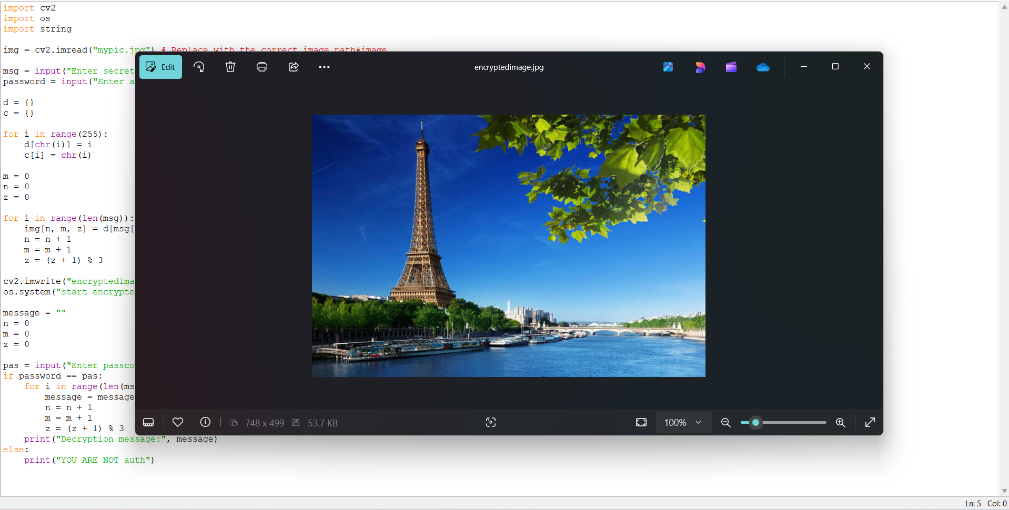
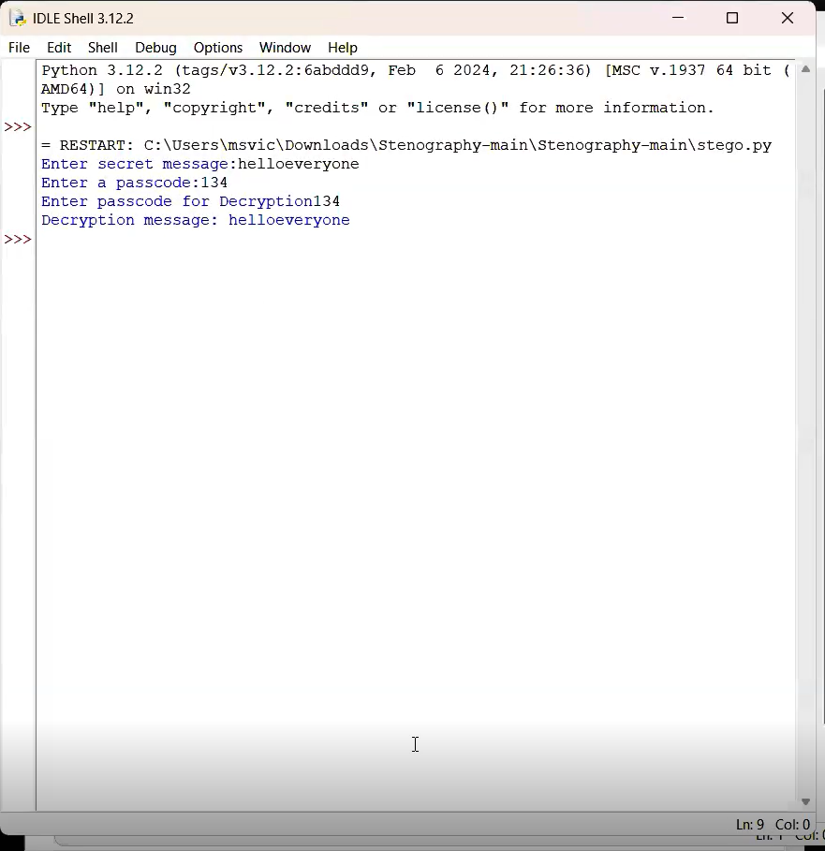
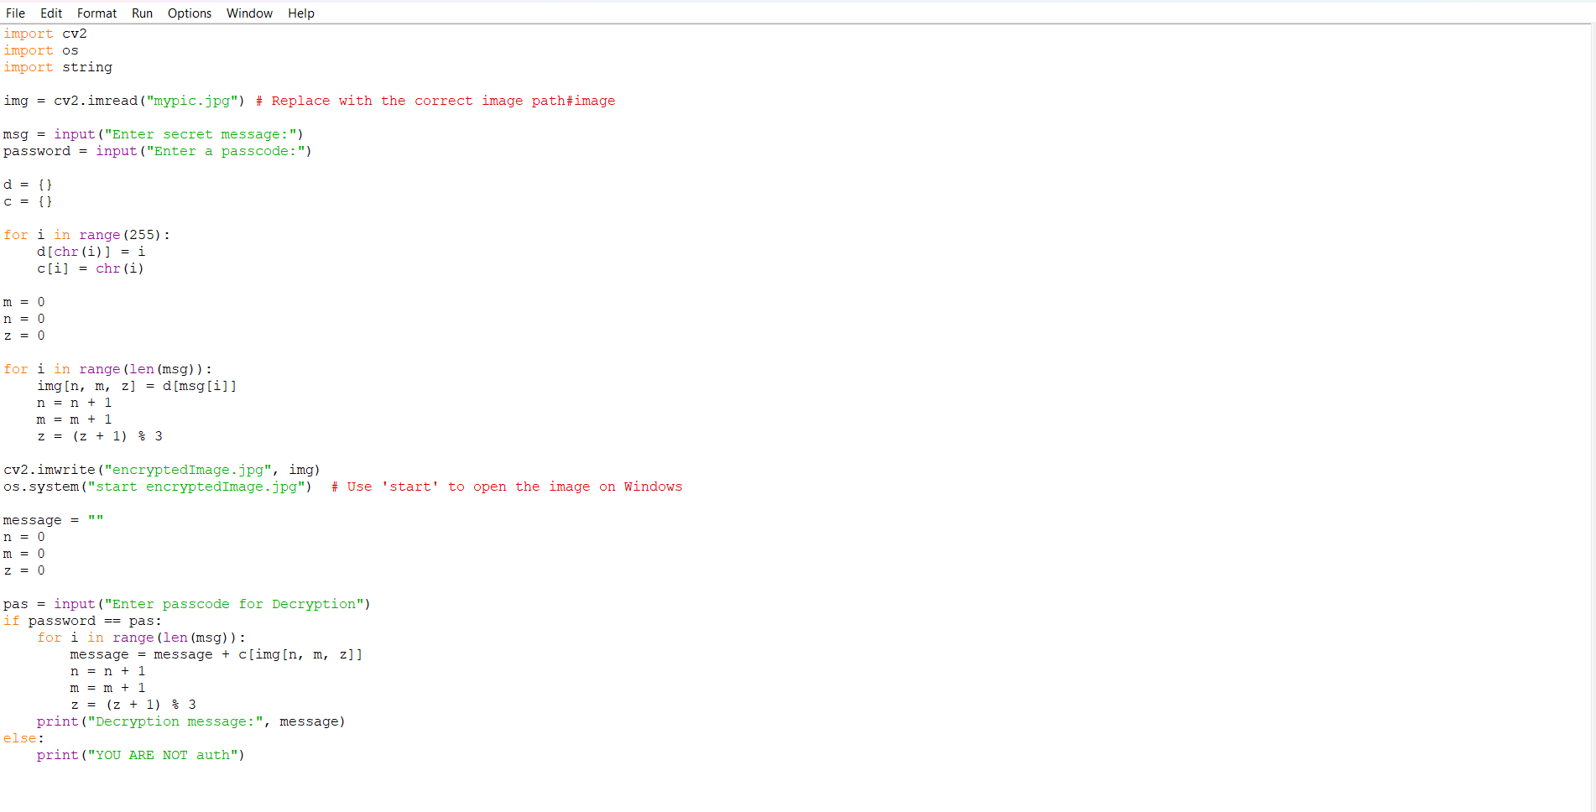

Results

Slide 8
Conclusion
This project successfully demonstrates a simple yet effective approach to image-based steganography. It provides a secure method for embedding messages into images and retrieving them using a passcode. Further enhancements can improve security and efficiency.

Slide 9
GitHub Link
https://github.com/Harini-Magesh/aicte_project.git

Slide 10
Future scope(optional)
Implementation of stronger encryption mechanisms.
Support for multiple image formats and larger message sizes.
Integration with mobile applications for easy use.

Slide 11
THANK YOU

